Slide 1
PICK FRESH
YASHASREE TUMMALA | FSJ0420A105

Slide 2
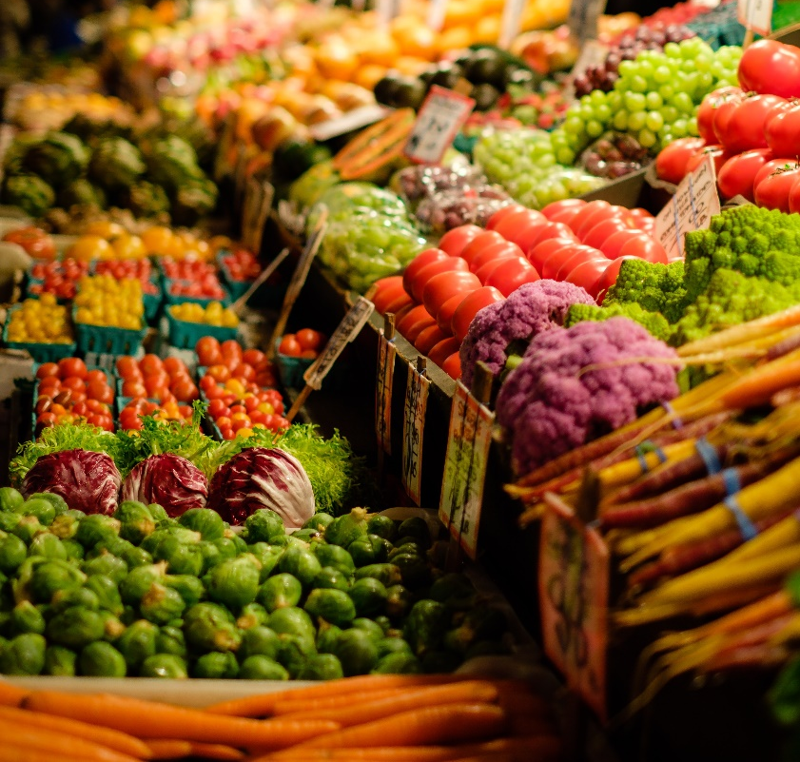
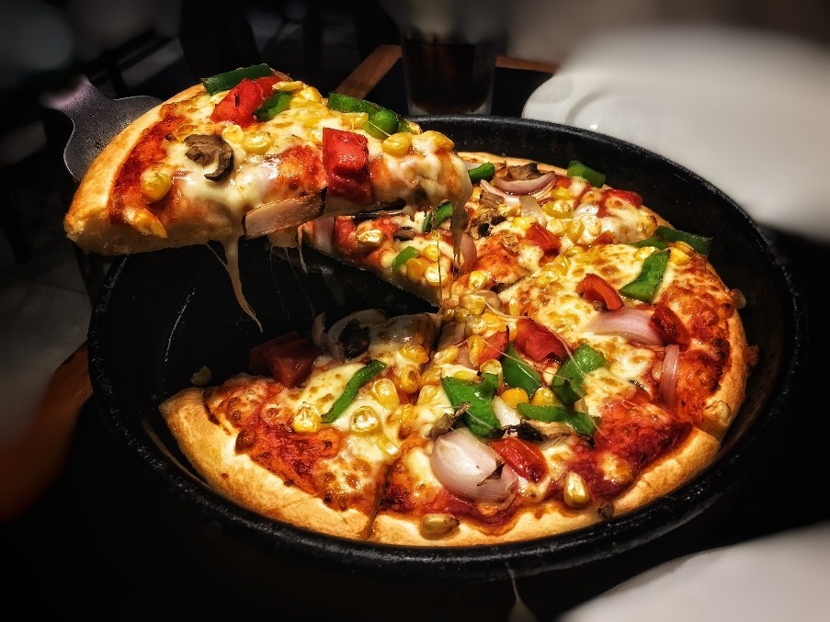
About The Project
Creating a global marketplace for every Buyer and Supplier to provide a Transparent, Competitive, Convenient and Uninfluential online trading platform.
Providing an understandable interface for consumers to shop the fresh yield
Providing Easy edibles like meal kit service
Reasons behind this Implementation:
Making everyone’s life easy and to support farmers.

Slide 3


What’s The Project All About?
Online Purchasing
Meal Kit Service
Eat Fresh

Slide 4
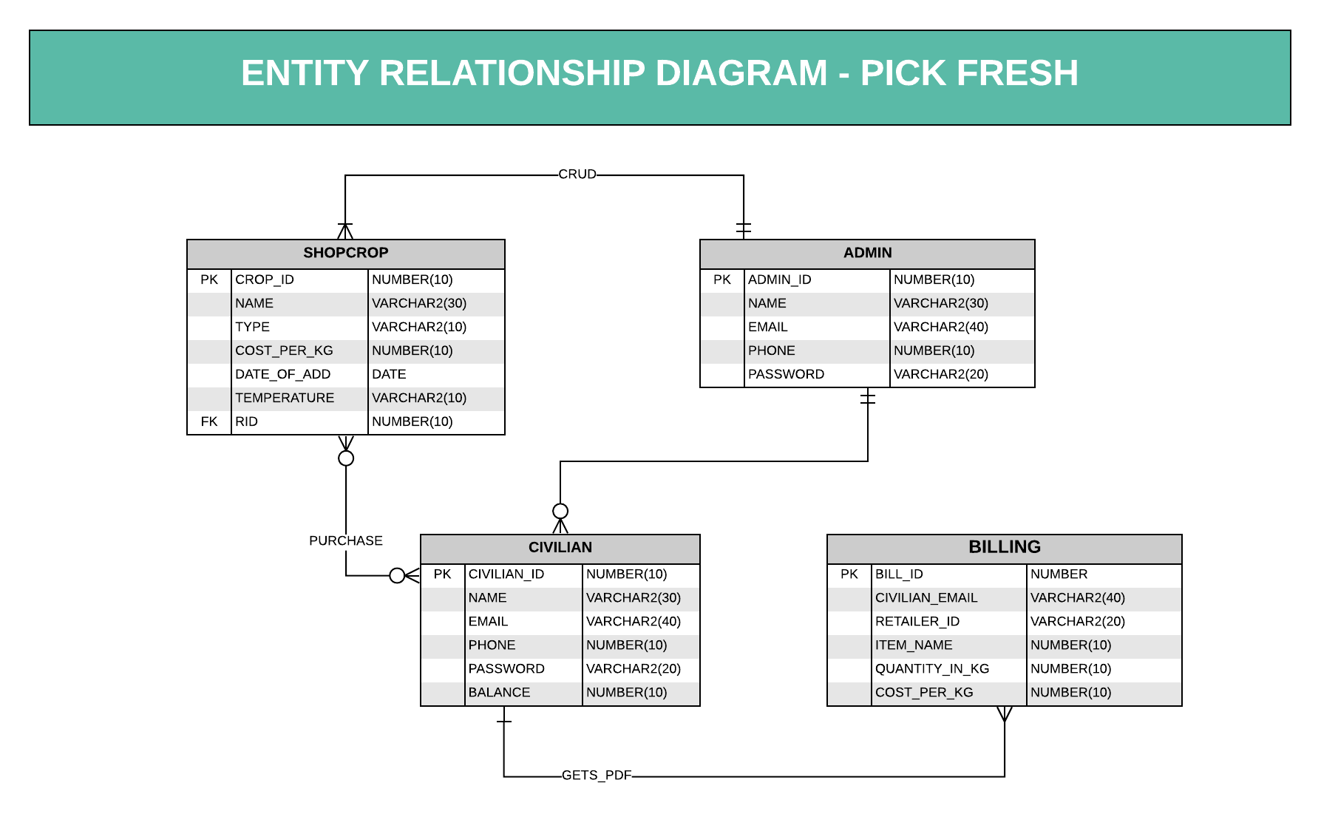

Slide 5
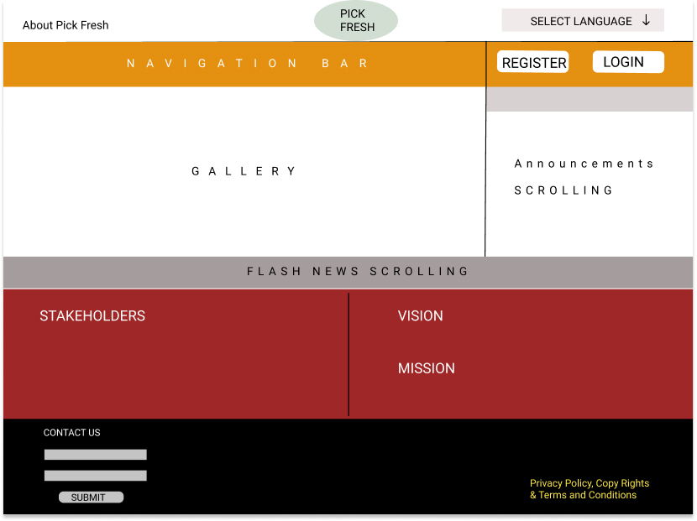
Home Page

Slide 6
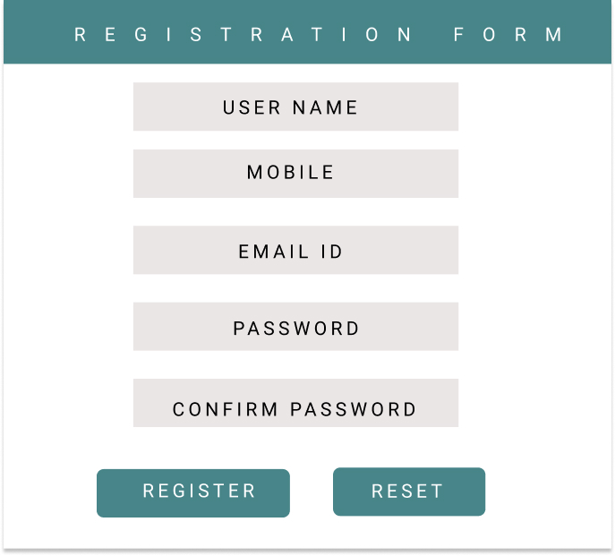
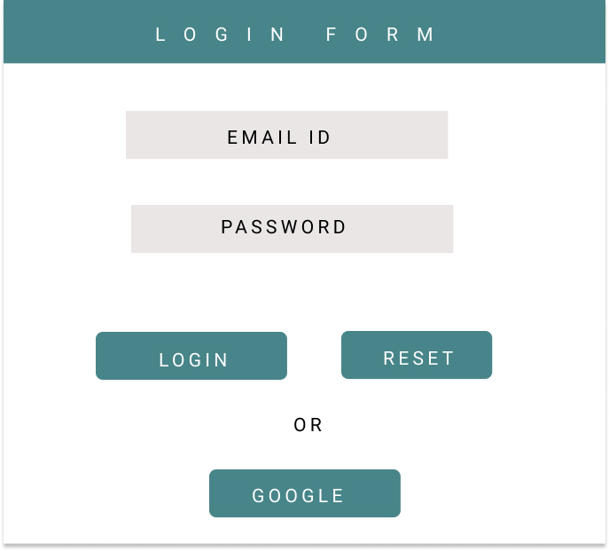
Registration & Login Pages

Slide 7
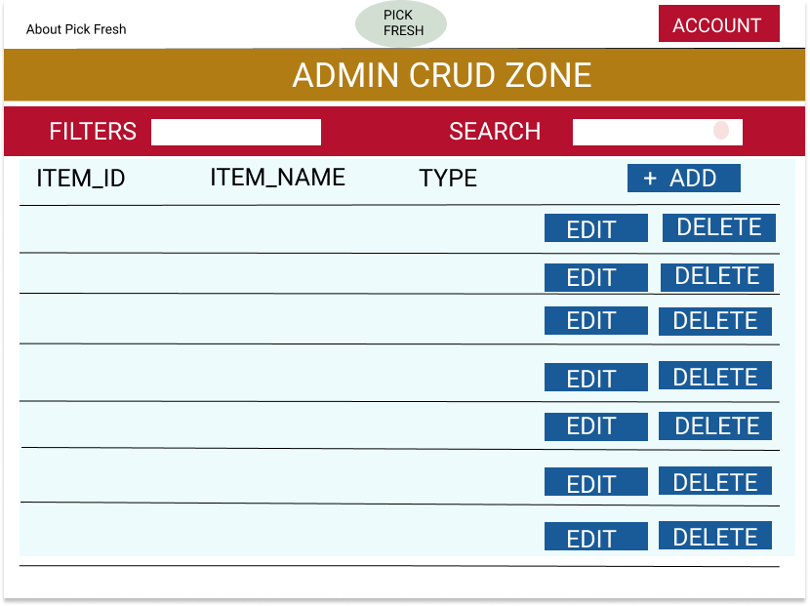
Admin CRUD

Slide 8
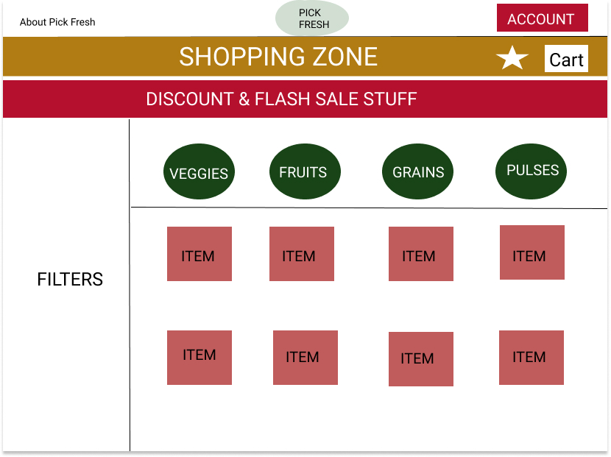
Shopping
The Silver Platter

Slide 9
Implementation Modules
Module | Concept used to implement the module | Module Finish Date
Wired Frames | Figma.com | Monday (06/07/20) by 8:00 P.M.
Creating Data (API) | My SQL | Tuesday (07/07/20) by 8:00 P.M.
Login, Registration, CROP (CRUD Operations) | JPA | Wednesday (08/07/20) by 8:00 P.M.
Login, Registration, CROP (CRUD Operations) | JPA | Thursday (09/07/20) by 8:00 P.M.
Testing the data & changes required | Postman/ Swagger | Friday (10/07/20) by 8:00 P.M.
Front end | ANGULAR MATERIAL | Saturday (11/07/20) by 8:00 P.M.
Front end | ANGULAR MATERIAL | Monday (13/07/20) by 8:00 P.M.
Front end | ANGULAR MATERIAL | Tuesday (14/07/20) by 8:00 P.M.
Testing the Application |  | Wednesday (15/07/20) by 8:00 P.M.
Testing the Application |  | Thursday (16/07/20) by 8:00 P.M.
Testing the Application |  | Friday (17/07/20) by 4:00 P.M.

Slide 10

Thank You

